Slide 1

CUSTOMER SEGMENTATION ANALYSIS

Slide 2

TEAM NAME : MILKY WAY
TEAM MEMBERS :
1.Afzal Ahamed A
2.Pooja Bhoomigha S
3.Chinmay Singole
4.Maddela Chahna Monica
5.Sabareeshwaran Suresh Kumar
6.Taneeru Anilkumar

Slide 3
INTODUCTION
THE CUSTOMER SEGMENTATION ANALYSIS DASHBOARD IS DESIGNED TO PROVIDE INSIGHTS INTO SALES PERFORMANCE, TRENDS, AND KEY PERFORMANCE INDICATORS (KPIS). IT ENABLES USERS TO EVALUATE REGIONAL, SEGMENT-WISE, AND CATEGORY-WISE CONTRIBUTIONS TO REVENUE AND PROFITABILITY. THIS TOOL SUPPORTS DATA-DRIVEN DECISION-MAKING BY HIGHLIGHTING KEY DRIVERS OF GROWTH AND AREAS REQUIRING OPTIMIZATION.
PURPOSE OF THE DASHBOARD:
1. Monitor Sales Performance: Track total sales, profit, and order volume across various dimensions such as regions and segments
.
2. Identify Trends: Analyze year-wise sales growth and category-wise contributions to revenue.
3. Evaluate Regional and Segment Insights: Compare performance metrics like average order value and profitability by region and customer segment.
4. Highlight Key Drivers of Revenue: Understand the impact of product categories on overall sales and profits.
5. Support Strategic Decisions: Provide a comprehensive view of business performance to identify opportunities and address challenges.

Slide 4
DATA SOURCE
The data was sourced from multiple channels, including:
Excel File:
Containing customer orders, sales, and product information.
For transactional data such as order history and regional performance metrics.
For real-time updates, such as geographic customer distribution
Data Cleaning:
Handled Missing Values: Missing entries in key columns (e.g., sales or profit) were replaced using logical estimates or averages.
Removed Duplicates: Ensured unique entries for customer IDs, orders, and products.
Standardized Formats: Unified date formats, currency values, and regional names for consistency.

Slide 5
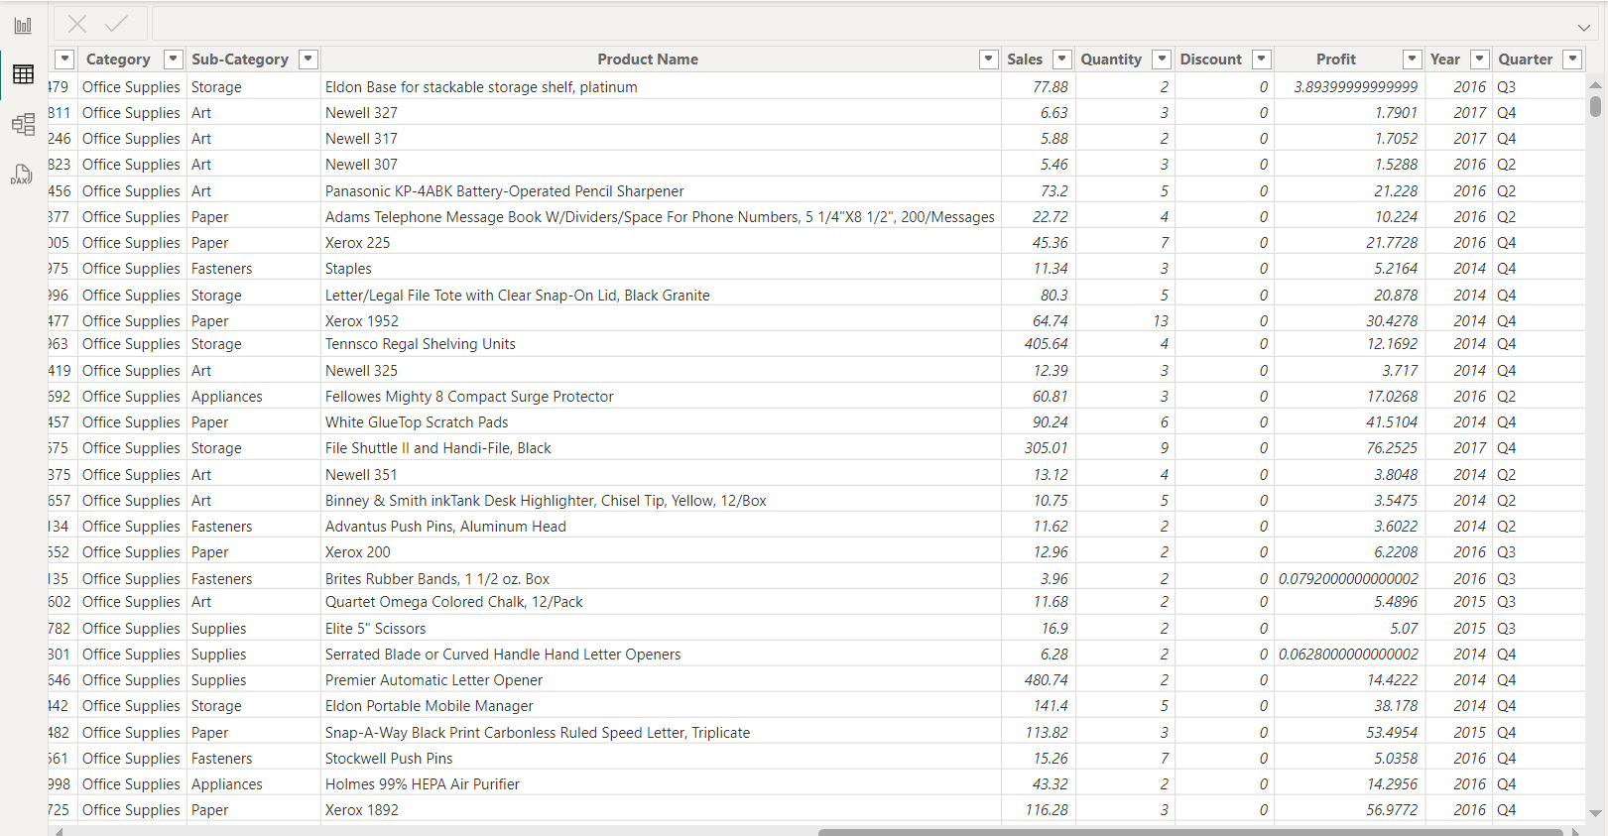
CLEANED DATASET
.

Slide 6
DATA TRANSFORMATION AND CHALLENGES
Data Transformation:
o Modeling for Analysis: Split raw data into manageable tables (e.g., region-wise, category-wise) and created relationships to maintain integrity.
o Calculated Metrics: Added derived columns for KPIs like average order value and sales growth percentage.
o Aggregations: Grouped data by regions, years, and customer segments to enable dynamic reporting.
Challenges and Resolutions:
• Inconsistent Data Formats: Resolved by defining custom transformations for formatting issues.
• Handling Outliers: Reviewed and flagged extreme values (e.g., unusually high order amounts) to validate data accuracy.
• Data Integration: Combined multiple sources using unique keys and merged tables seamlessly through Power Query.
This meticulous approach ensured clean, structured data ready for analysis and visualization in Power BI.

Slide 7
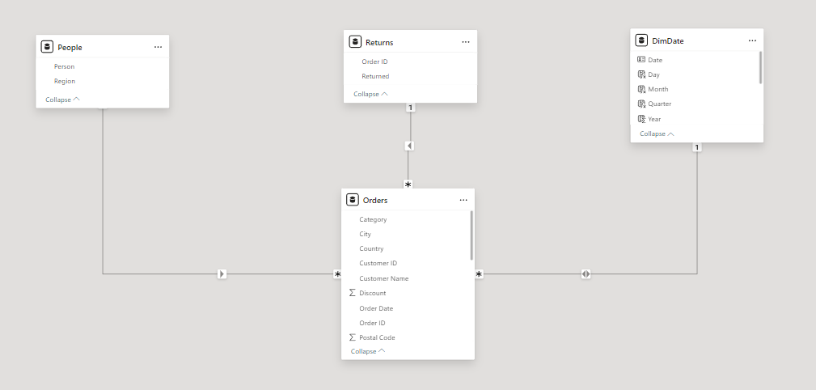
DATA MODELLING
TABLES:
Orders Table:
Stores transactional data, including Order Date, Customer ID, Category, City, and sales-related metrics like Discount.
DimDate Table:
A date dimension that includes attributes like Day Number, Month, and Is Weekend
People Table
Contains employee or personnel information (columns not fully described)
Returns Table:
Tracks returned products, potentially including Order ID and Return Reason

Slide 8


MEASURES
AGGREGATION:
AVERAGE provides the central tendency or mean of the data.
SUM gives the cumulative value for a specific field.
MIN and MAX are used for identifying boundaries in data (smallest and largest values)

Slide 9
MEASURES
TIME INTELLIGENCE:
1. DATESINPERIOD
Definition: Returns a table containing a set of dates within a specific period, starting from a given date.
2. PREVIOUSMONTH
Definition: Returns a table containing all the dates from the previous month, based on the context of the provided date column.
3. PREVIOUSDAY
Definition: Returns a table containing the dates for the previous day, based on the context of the provided date column.
4. SAMEPERIODLASTYEAR
Definition: Returns a table containing the same dates from the previous year, based on the context of the provided date.

Slide 10
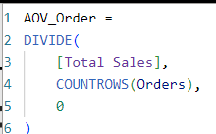
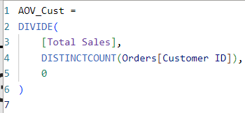
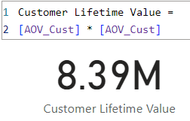
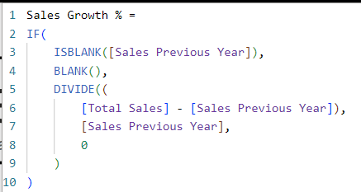
MEASURES
DAX CALCULATION:
The majorly used DAX measures are attach in this slide , The measeure like
Average order value (AOV) per order
Average order value (AOV) per customer
Sales Growth % over year
4.Customer lifetime value

Slide 11
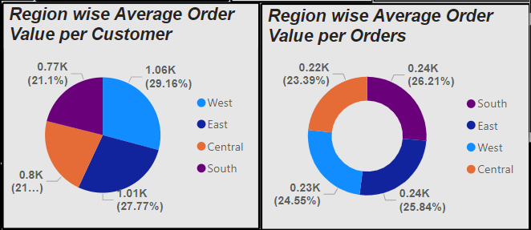
REGIONAL SALES & ORDER VALUE
Average Order Value per Customer and Order for regions like West, East, Central, and South.
PIE and DONUT VISUAL:
Pie charts provide a proportional view of average order value across regions, focusing on both customers and orders.
Similar to a pie chart but with a hollow center, making it visually cleaner and allowing space for a label or additional information in the middle.
INSIGHTS:
Highest order values are in the East and South.
West has the lowest average but may have a higher customer count.
The chart shows the "Region wise Average Order Value per Orders," with the South region having the highest average order value, followed closely by the East region.

Slide 12
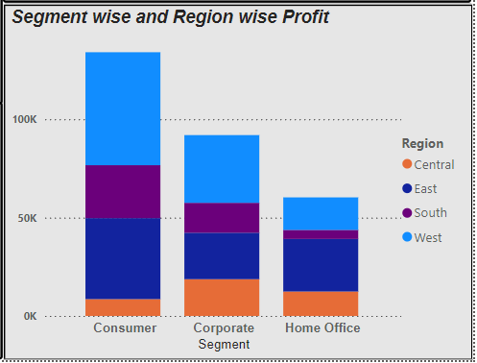
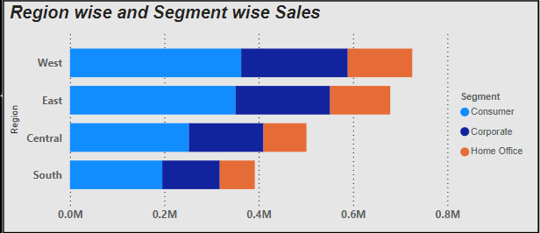
PROFIT,SALES BY SEGMENT AND REGION
Analyzing Profit and Sales trend for Consumer, Corporate, and Home Office segments and regions like East, West, Central and South.
STACKED COLUMN CHART AND STACKED BAR CHART:
Stacked column charts use vertical bars, with segments representing subcategories stacked on top of each other.
Stacked bar charts display data using horizontal bars, where each bar is divided into segments representing subcategories.
INSIGHTS:
West Region has the highest total sales, with a significant contribution from the Consumer segment.
The Consumer segment contributes the highest profit across all regions, with the West and East regions leading in profitability.

Slide 13
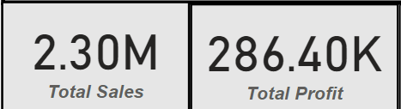
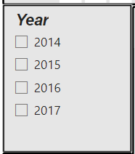
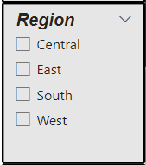
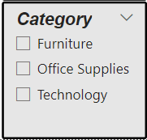
USEAGE OF SLICERS AND CARDS
Total sales and Total profit based on Year , Region & Category
CARDS AND SLICERS :
Cards are used to highlight key metrics like Total Sales ($2.3M) and Total Profit ($286.4K) for a quick overview.
Enables filtering by geographical regions (Central, East, South, West)
INSIGHTS:
Total Sales and Profit provide a snapshot of business performance. These numbers serve as benchmarks for evaluating trends and profitability.
Most profitable and least profitable regions

Slide 14
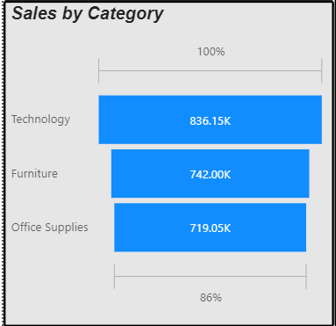
SALES BY CATEGORY
Sales performance for Technology, Furniture, and Office Supplies.
FUNNEL VISUAL:
The funnel visual is likely used to represent a step-by-step process or hierarchical breakdown of metrics.
INSIGHTS:
Analyze how many customers, orders, or sales are retained at each stage.
Identify stages with significant drop-offs to optimize processes.

Slide 15
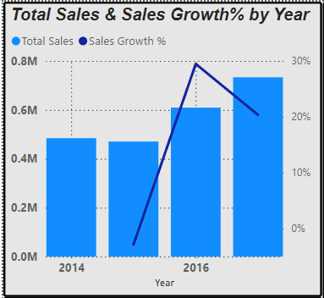
SALES GROWTH BY YEAR
Sales performance for Technology, Furniture, and Office Supplies.
STACKED COLUMN CHART AND STACKED BAR CHART:
A Line and Stacked Column Chart combines stacked columns with a line chart in a single visualization.
It is used to compare individual components (stacked values) and simultaneously visualize trends or metrics over time or categories (using the line).
INSIGHTS:
2017 has the highest sales
Line graph shows increase in sales growth after 2015 and decrease in sales after 2016

Slide 16
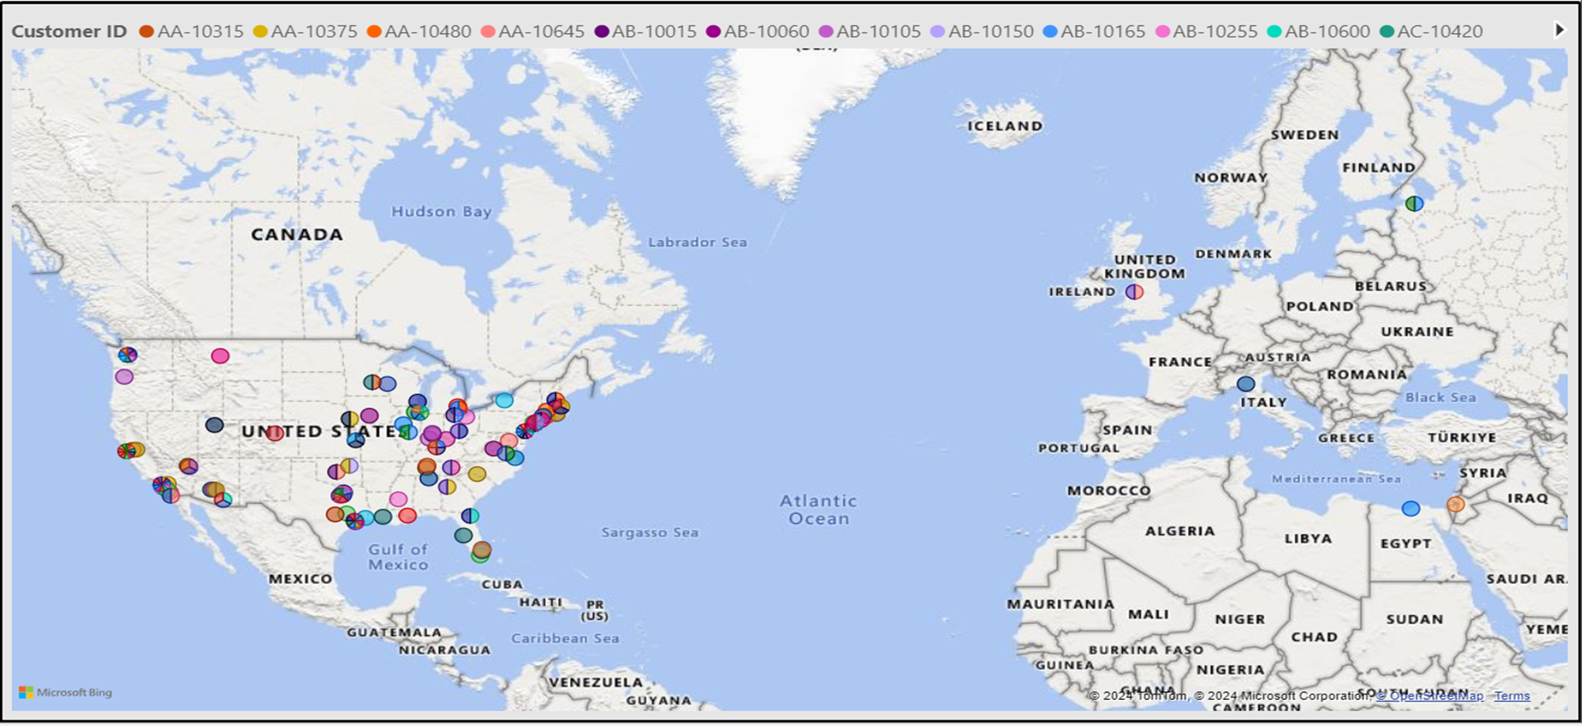
GEOGRAPHIC DISTRIBUTION
A map visual gives a clear understanding of where customers are concentrated
Most customers are located in North America, with some presence in Europe and Africa. This helps in identifying potential regions for expansion or targeted marketing.

Slide 17
THANK YOU

